Slide 1
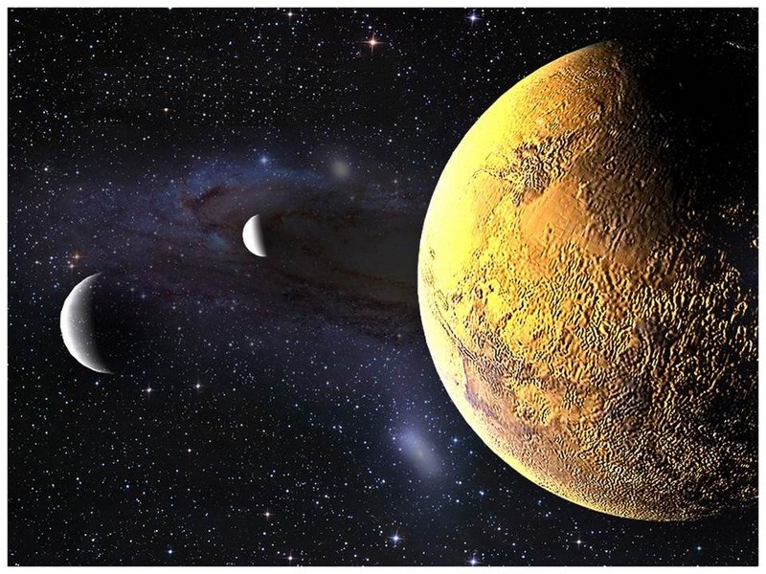
S.O.L.I.D.
Single Responsibility Principle

Slide 2

Definition
Introduced by Robert Martin (Uncle Bob) in
Principles of Object Oriented Design
A class should:
have all of its services narrowly aligned
only ever have one reason to change

Slide 3
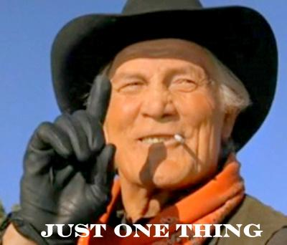
Why? High Cohesion
Robust classes
Improved code reuse
I’m lost - too much
going on!

Slide 4
Why? Change agents
Know where in the code to make a change
Responsibilities tied to people
Understand your change agents (the people)
Unaffected by “ancillary changes”
Confidence in your code

Slide 5

How?
Break it down!
Notes:
Large methods into smaller methods
Large classes into smaller classes
Separate concerns & reassemble

Slide 6

How?
Look for opportunities
for reuse
Notes:
Look for patterns
Abstract common functionality
Introduce helpers

Slide 7
How? Code Smells
Methods of greater than 5 lines
Conjunctions in names: And/Or
More than 3 words in a method
Lines of code in a class
You should never get lost
Multiple actors with multiple goals
Copy-paste programming
Notes:
Methods should practice SRP too. More than 5 lines means it is probably doing multiple things.
Examples:
GenerateAndPrintReport - Clearly has multiple responsibilities
LogOrEmailError - see this a lot. Method has 2 paths based on some condition, where the fork leads to 2 separate responsibilities. Although only one responsibility may execute at a time, both responsibilities are coupled to the method.
Example:
ParseInputForDatabase - Probably need code whose responsibility is parsing, and perhaps an abstraction of “Database”. Reminder: look for patterns. If you need to parse for other systems besides the database, consider a polymorphic pattern where each class is responsible for parsing for its own system.
If your class is sufficiently cohesive, you shouldn’t have to keep scrolling around trying to find what you are looking for.
Example:
The account department wants X, Y, and Z fields stored in the database
The IT governance committee insists on columns Y and Z to be encrypted
One class is responsible for persistence (saving to the database) and one class is responsible for securing the data

Slide 8
Recap - Definition
Introduced by Robert Martin (Uncle Bob) in
Principles of Object Oriented Design
A class should:
have all of its services narrowly aligned
only ever have one reason to change

Slide 9
Kata – Mars Rover
.NET and Java
Two functional code bases
One with no respect to SRP
One implemented with SRP in mind
Groups of 3 or 4
Good mix of experience level
Try not to “cheat”
Refer to SRP reference implementation later

Slide 10
Current Rover Responsibilities
Its own movement
Planet’s properties
Managing obstacles
Validating positions
Instructions
Create Mars class
Move Mars behavior to Mars class
Refactor MissionController Rover to take in new Mars
- Rover
- Mars
- Mars
- Mars

Slide 11
Possible Solution
Rover
Rover
Mars
Movement
Mars Landing
Boundaries
Coordinates
Obstacles
Separation of concerns
Methods put in classes that make logical sense
Notes:
Talk to these being the types of methods that get split out and not the methods themselves

